Slide 1






Powering the Entire Real Estate Lifecycle
COMMERCIAL PROPOSAL
OPTIMA CRM
(STANDARD EDITION)
This proposal is confidential and intended solely for the recipient. All terms are subject to the standard SaaS agreement of OptimaVentures.
powered by

Slide 2





About Optima CRM
Helping real estate agencies in the UAE close more deals, save time, and gain full visibility of their business.
Optima CRM is designed to simplify challenges such as:
Centralizing all leads and property listings in one platform.
Automating repetitive tasks such as lead assignment and portal integrations.
Improving agent productivity with structured workflows.
Providing visibility for managers to monitor performance.

Slide 3








Optima CRM Optimizes Six Key Operational Areas in Real Estate
Never Lose a Lead Again
02
Manage Listings & Projects
04
Manage Rentals & Maintenance
06
Lead capture from all portals and WhatsApp
Centralized control and accuracy across platforms
Renewals, invoicing, and maintenance tracking
Stay on Top of Every Opportunity
Close Deals Faster
Get Full Visibility
Automated offers, invoicing, and payments
Dashboards and performance analytics
Agent accountability and timely follow-ups
01
03
05

Slide 4
















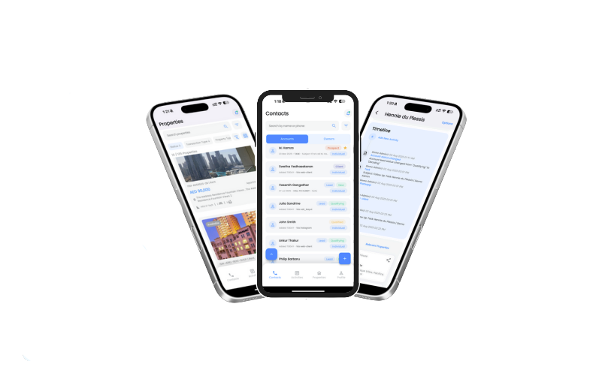
Optima CRM: Bridging Multiple Lead Sources into One Platform
Optima CRM connects your entire lead ecosystem into a single hub, so you never miss a deal.

Slide 5
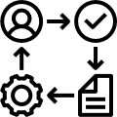
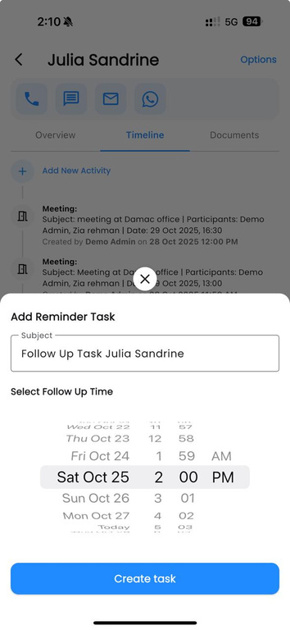
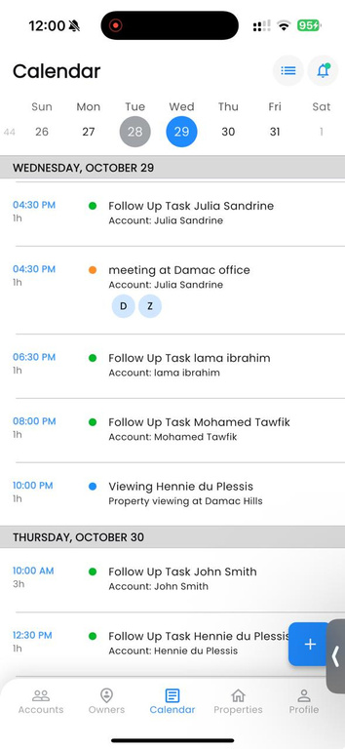

Empowering Agents with Real-Time Mobile Lead Management
Optima CRM ensures every lead is captured, tracked, and assigned seamlessly.
Automatic Assignment
Leads are auto-assigned to agents based on defined rules (e.g., round-robin or performance-based).
Lead Tracking
Monitor lead status from new inquiry → active → closed.
Follow-up & Reminders
Ensure no lead is missed with built-in reminders and notifications.

Slide 6
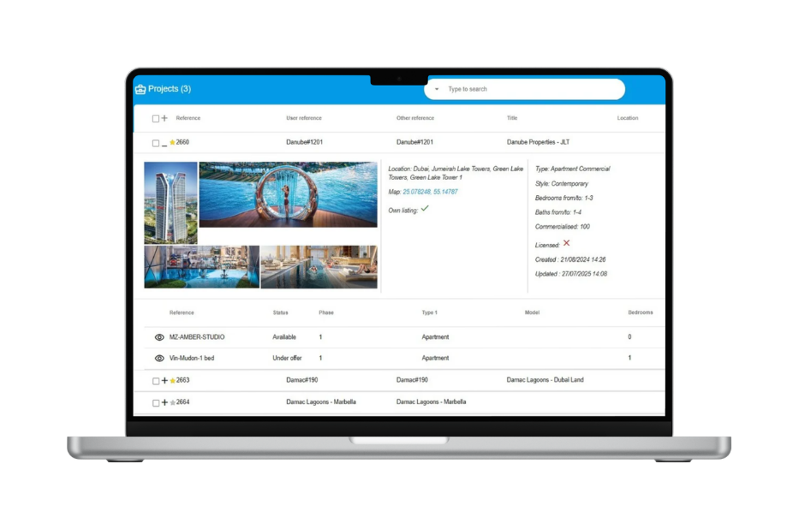

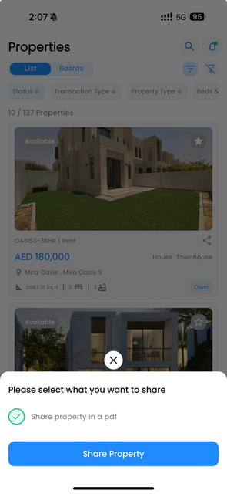


Optima CRM provides a centralized solution to manage and publish property listings efficiently.
Property Database
Create and manage property listings with images, descriptions, and pricing details.
Duplicate Control
Avoid duplicate listings by automated property checks.
Agent Access
Give authorized access to agents for viewing or editing listings.

Slide 7
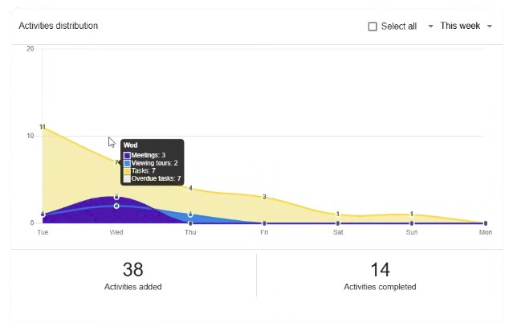
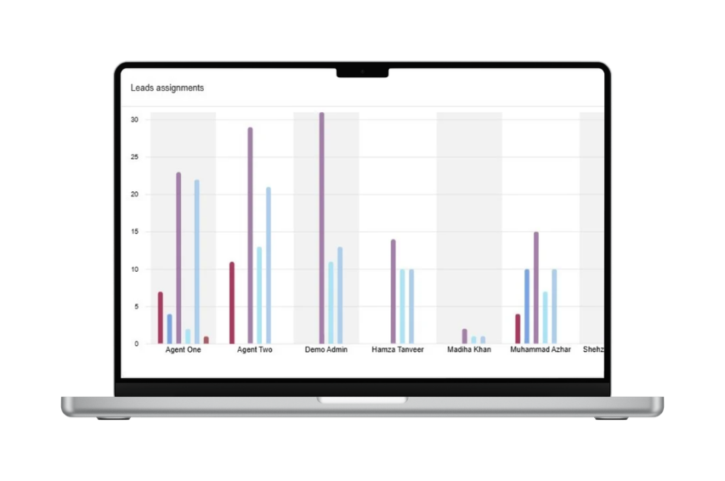
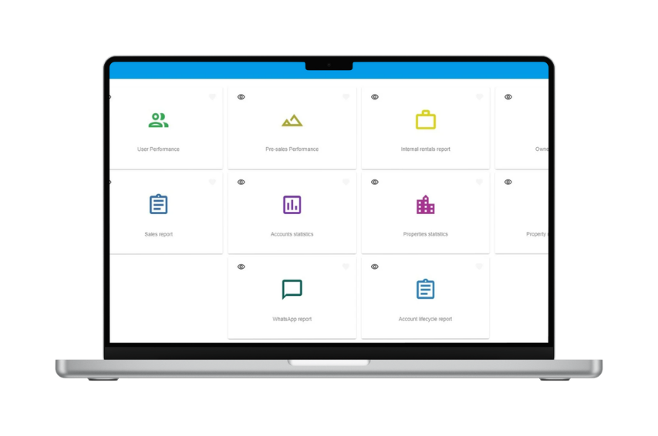
Real-Time Insights to Drive Smarter Sales Outcomes

Slide 8
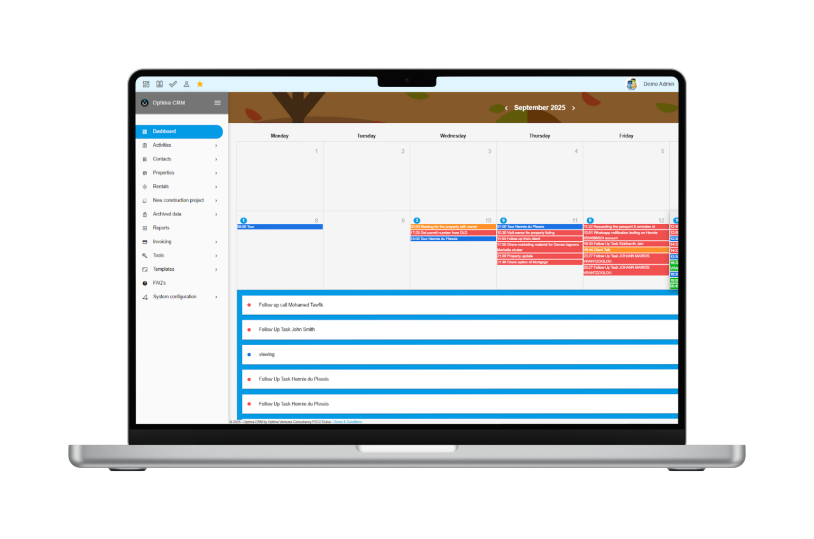
Stay on Track with Follow-Ups & Reminders

Slide 9









Lease Contract, Maintenance &
Invoicing Management
Lease
Digital Property Profiles
Every property in Optima CRM is a live digital profile—connecting rental contracts, images, documents, service requests, and tenant data.
Maintenance
Tenant
Real-Time Access
Receive real-time alerts and enjoy full access to clients, owners, and properties from anywhere.
Project Info
Property
Automated Reminders
Simplified Lease Management
Create and manage leases, and easily track payments, renewals, and deposits.
Grouping
Photos

Slide 10












OPTIMA CRM SECURITY OVERVIEW
Protecting Your Real Estate Data with Enterprise-Grade Cloud Security
Secure Cloud Infrastructure
Data Encryption
Role-Based Access Control
Automated Backups
Activity Monitoring
Regular Security Updates
Enterprise-Grade Data Centers
24/7 Monitoring
Firewalls & DDoS Protection
Encrypted In Transit & At Rest
HTTPS / SSL Security
User Permissions
Role-Based Access
Restricted Data Viewing
Daily Backup & Recovery
Data Loss Protection
Audit Logs
User Activity Tracking
Patches & Upgrades
Threat Protection
01
02
03
04
05
06
Why Cloud SaaS is Safer Than On-Premise
Office Server
Hardware Failure Risk
Manual Backups
Limited IT Security
Local Risks (Fire/Theft)
Optima CRM Cloud
✓ Redundant
✓ Automated Backups
✓ Enterprise Protection
✓ Secure Data Centers

Slide 11






Trusted by Leading Companies

Slide 12
Start Your Optima CRM Subscription
The subscription charges are per user per month
Optional Add-Ons: WhatsApp marketing funnels via Meta Business API and real-time website property listing integration (API + CMS) are available at additional cost upon request.

Slide 13
No Initial Setup Fee

Slide 14




THANK
YOU
+971 588 706 162
info@optimaventures.ae
powered by
Dubai Silicon Oasis, UAE

